Slide 1
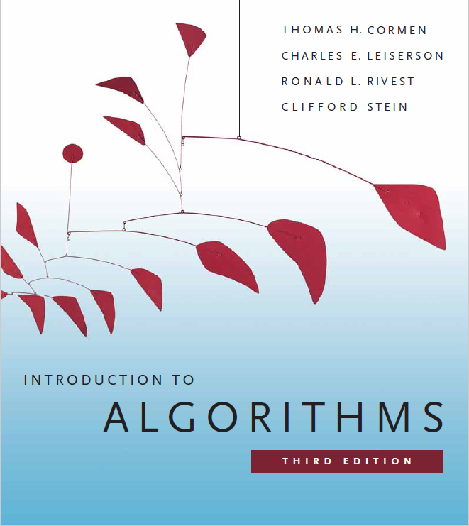
Disjoint Sets
Prepared by Shmuel Wimer
Courtesy of Prof. Dror Rawitz

Slide 2
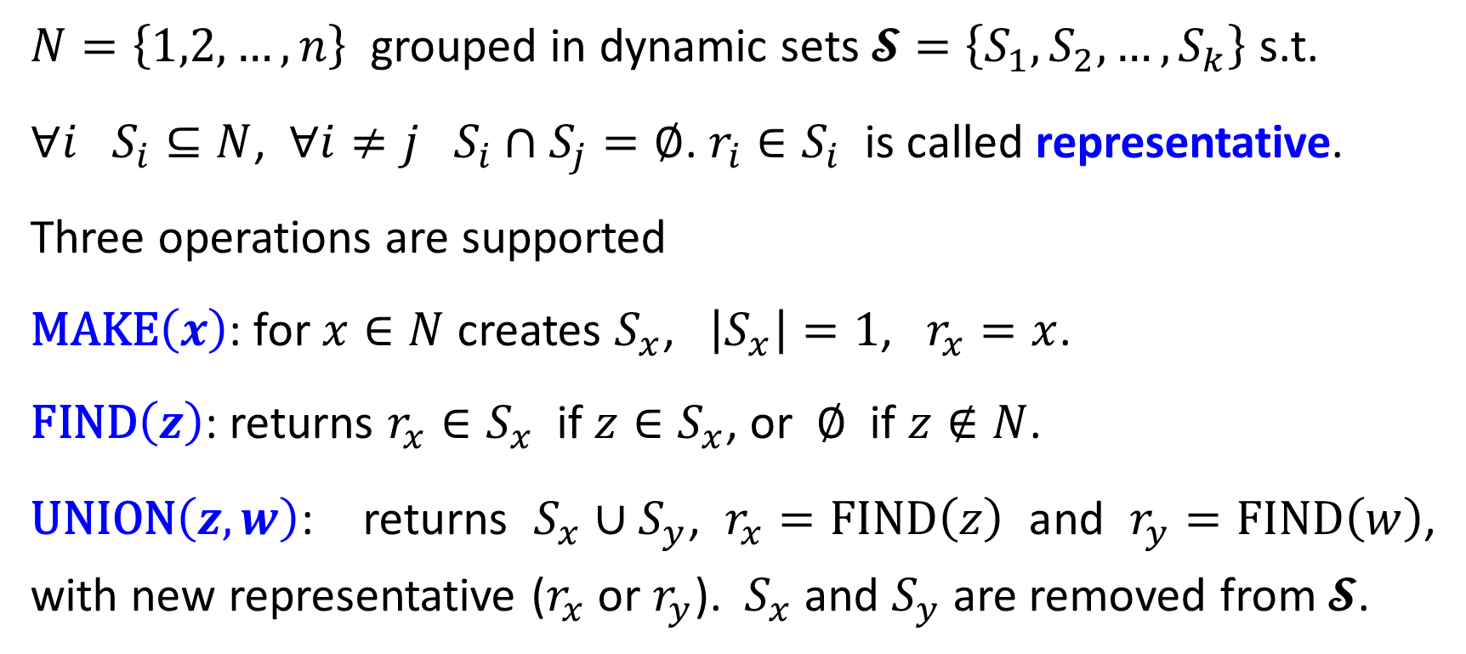
Disjoint-Set Operations
$N=\left\{1,2,…,n\right\}$ grouped in dynamic sets $𝓢=\left\{S_{1},S_{2},…,S_{k}\right\}$ s.t.
$∀i S_{i}⊆N$, $∀i≠j S_{i}∩S_{j}=∅$. $r_{i}∈S_{i}$ is called representative.
Three operations are supported
$\text{MAKE}\left(x\right)$: for $x∈N$ creates $S_{x}$, $\left|S_{x}\right|=1$, $r_{x}=x$.
$\text{FIND}\left(z\right)$: returns $r_{x}∈S_{x}$ if $z∈S_{x}$, or $∅$ if $z∉N$.
$\text{UNION}\left(z,w\right)$: returns $S_{x}∪S_{y}$, $r_{x}=\text{FIND}\left(z\right)$ and $r_{y}=\text{FIND}\left(w\right)$, with new representative ($r_{x}$ or $r_{y}$). $S_{x}$ and $S_{y}$ are removed from $𝓢$.

Slide 3
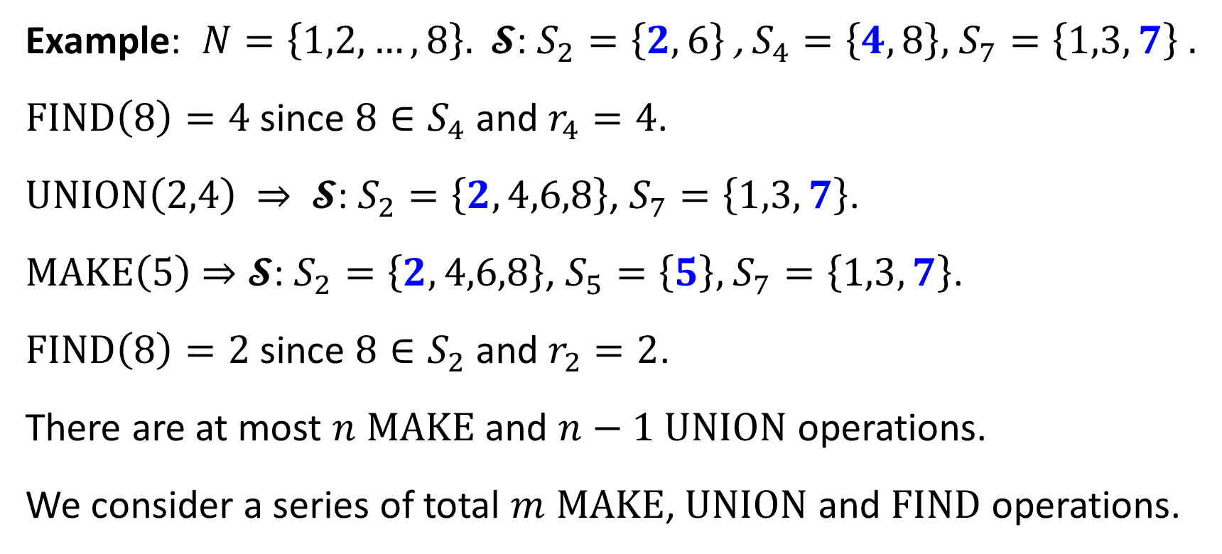
Example: $N=\left\{1,2,…,8\right\}$. $𝓢$: $S_{2}=\left\{2,6\right\}$ , $S_{4}=\left\{4,8\right\}$, $S_{7}=\left\{1,3,7\right\}$ .
$\text{FIND}\left(8\right)=4$ since $8∈S_{4}$ and $r_{4}=4$.
$\text{UNION}\left(2,4\right)$ ⇒ $𝓢$: $S_{2}=\left\{2,4,6,8\right\}$, $S_{7}=\left\{1,3,7\right\}$.
$\text{MAKE}\left(5\right)$ ⇒ $𝓢$: $S_{2}=\left\{2,4,6,8\right\}$, $S_{5}=\left\{5\right\}$, $S_{7}=\left\{1,3,7\right\}$.
$\text{FIND}\left(8\right)=2$ since $8∈S_{2}$ and $r_{2}=2$.
There are at most $n$ $\text{MAKE}$ and $n−1$ $\text{UNION}$ operations.
We consider a series of total $m$ $\text{MAKE}$, $\text{UNION}$ and $\text{FIND}$ operations.

Slide 4
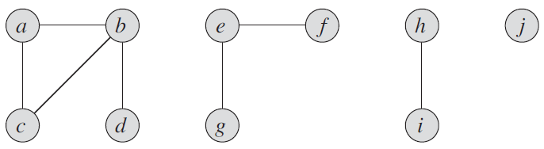
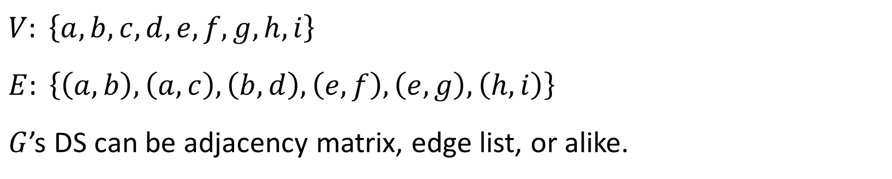
Example: Find the connected components of simple graph $G\left(V,E\right)$.
$V: \left\{a,b,c,d,e,f,g,h,i\right\}$
$E: \left\{\left(a,b\right),\left(a,c\right),\left(b,d\right),\left(e,f\right),\left(e,g\right),\left(h,i\right)\right\}$
$G$’s DS can be adjacency matrix, edge list, or alike.

Slide 5
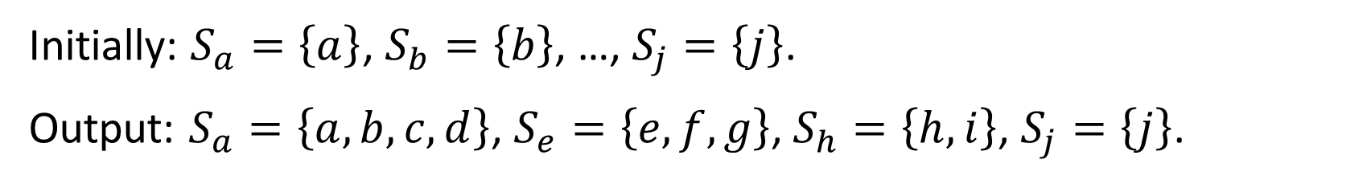
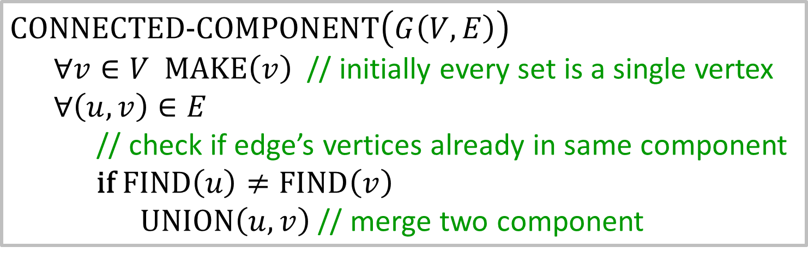
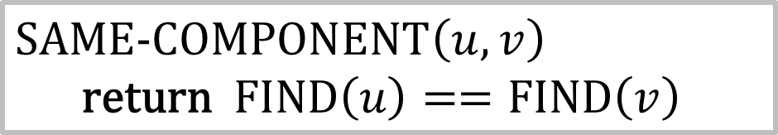
$\text{CONNECTED}\text{−}\text{COMPONENT}\left(G\left(V,E\right)\right)$
$∀v∈V \text{MAKE}\left(v\right)$ // initially every set is a single vertex
$∀\left(u,v\right)∈E$
// check if edge’s vertices already in same component
$\text{if} \text{FIND}\left(u\right)≠\text{FIND}\left(v\right)$
$\text{UNION}\left(u,v\right)$ // merge two component
Initially: $S_{a}=\left\{a\right\}$, $S_{b}=\left\{b\right\}$, …, $S_{j}=\left\{j\right\}$.
Output: $S_{a}=\left\{a,b,c,d\right\}$, $S_{e}=\left\{e,f,g\right\}$, $S_{h}=\left\{h,i\right\}$, $S_{j}=\left\{j\right\}$.
$\text{SAME}\text{−}\text{COMPONENT}\left(u,v\right)$
$\text{return}$ $\text{FIND}\left(u\right)==\text{FIND}\left(v\right)$

Slide 6
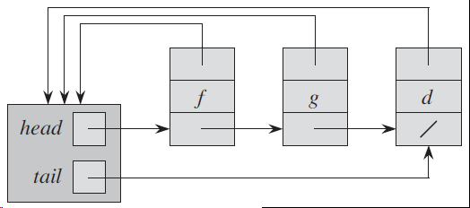
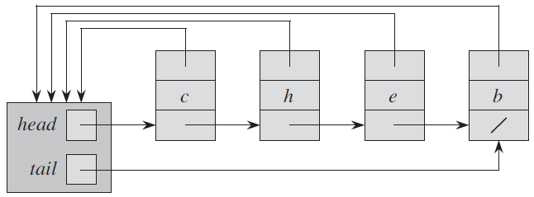
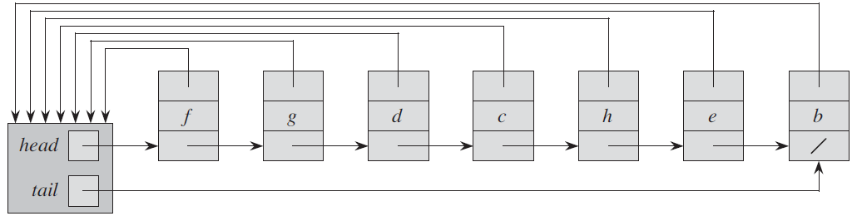







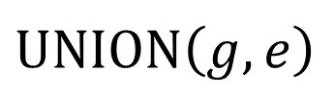










Linked List Representation
$$f$$
$$g$$
$$d$$
$$c$$
$$h$$
$$e$$
$$b$$
$$S_{f}$$
$$S_{c}$$
$\text{MAKE}$and $\text{FIND}$ require $O\left(1\right)$ time.
$$f$$
$$g$$
$$d$$
$$c$$
$$h$$
$$e$$
$$b$$
$$S_{f}$$
$\text{UNION}\left(g,e\right)$
Naive $\text{UNION}$ implementation takes $O\left(n\right)$ due to pointer updates.

Slide 7
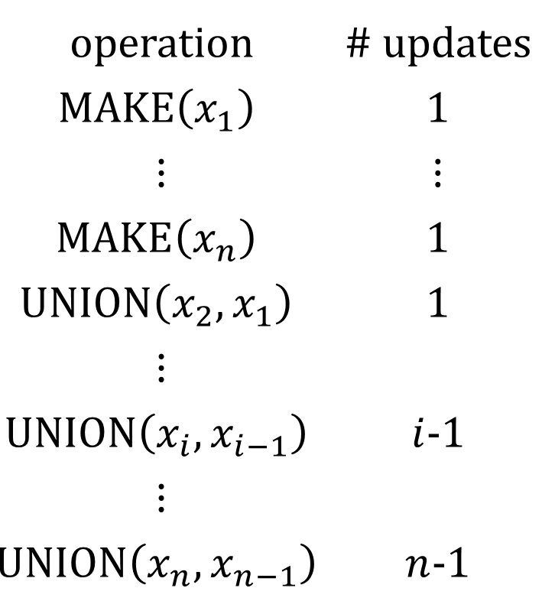
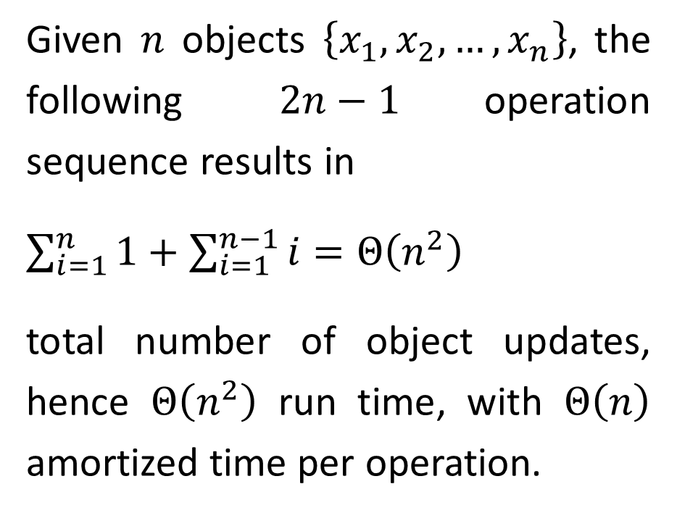
operation | # updates
$$\text{MAKE}\left(x_{1}\right)$$ | 1
⋮ | ⋮
$$\text{MAKE}\left(x_{n}\right)$$ | 1
$$\text{UNION}\left(x_{2},x_{1}\right)$$ | 1
⋮
$$\text{UNION}\left(x_{i},x_{i−1}\right)$$ | $i$-1
⋮
$$\text{UNION}\left(x_{n},x_{n−1}\right)$$ | $n$-1
Given $n$ objects $\left\{x_{1},x_{2},…,x_{n}\right\}$, the following $2n−1$operation sequence results in
$\sum_{i=1}^{n}{1}+\sum_{i=1}^{n−1}{i}=Θ\left(n^{2}\right)$
total number of object updates, hence $Θ\left(n^{2}\right)$ run time, with $Θ\left(n\right)$ amortized time per operation.

Slide 8
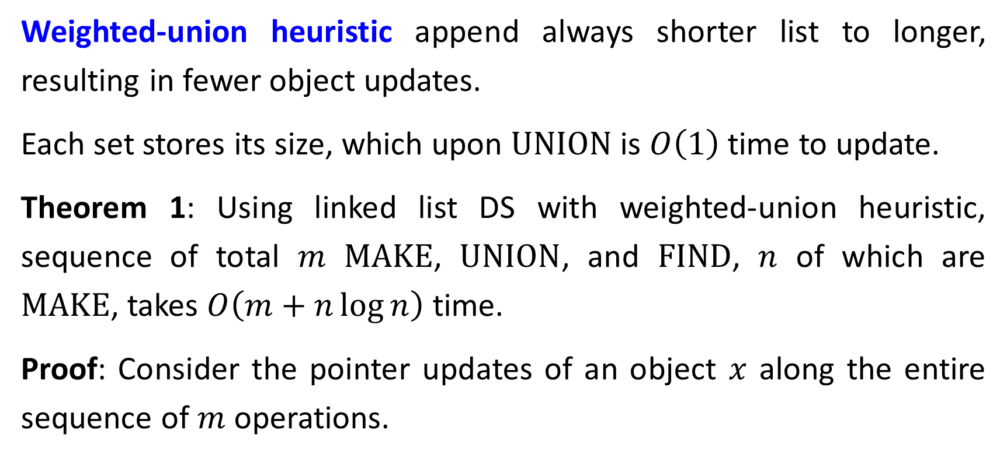
Weighted-Union Heuristic
Weighted-union heuristic append always shorter list to longer, resulting in fewer object updates.
Each set stores its size, which upon $\text{UNION}$is $O\left(1\right)$ time to update.
Theorem 1: Using linked list DS with weighted-union heuristic, sequence of total $m$ $\text{MAKE}$, $\text{UNION}$, and $\text{FIND}$, $n$ of which are $\text{MAKE}$, takes $O\left(m+n\log{n}\right)$ time.
Proof: Consider the pointer updates of an object $x$ along the entire sequence of $m$operations.

Slide 9
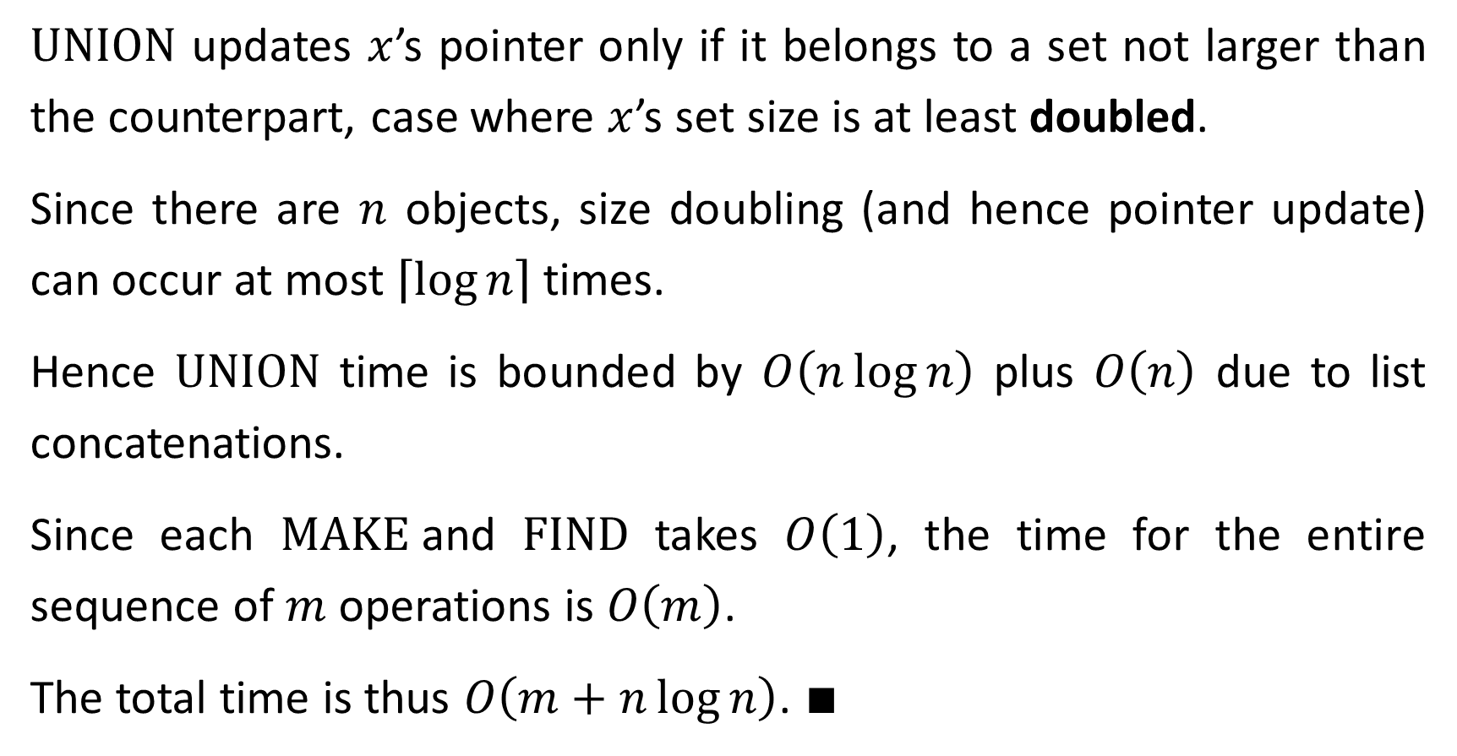
$\text{UNION}$ updates $x$’s pointer only if it belongs to a set not larger than the counterpart, case where $x$’s set size is at least doubled.
Since there are $n$ objects, size doubling (and hence pointer update) can occur at most $\left\lceil \log{n}\right\rceil$ times.
Hence $\text{UNION}$ time is bounded by $O\left(n\log{n}\right)$ plus $O\left(n\right)$ due to list concatenations.
Since each $\text{MAKE}$and $\text{FIND}$ takes $O\left(1\right)$, the time for the entire sequence of $m$ operations is $O\left(m\right)$.
The total time is thus $O\left(m+n\log{n}\right)$. ∎

Slide 10
Disjoint-Set Forests
Run time speedup is achieved by rooted trees, with each node containing one member and each tree representing one set.
Each member points only to its parent. The root contains the set’s representative and it is its own parent.
The speedup is enabled by two heuristics: union by rank and path compression.
Disjoint-set forests is asymptotically optimal disjoint-set DS, achieving almost linear run-time (shown later).

Slide 11
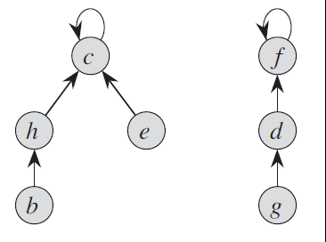
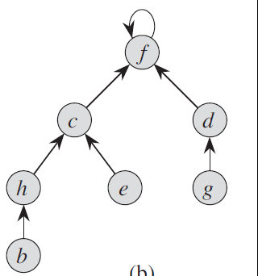

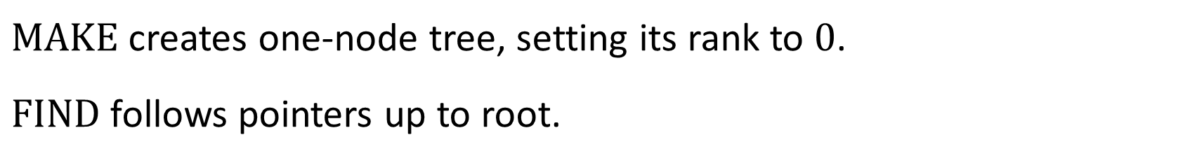

$$\text{UNION}\left(e,g\right)$$
$\text{MAKE}$ creates one-node tree, setting its rank to $0$.
$\text{FIND}$ follows pointers up to root.
$\text{UNION}$ causes pointer of one tree to point to other’s root. Poor implementation may create a tree that is linear chain of $n$ nodes.

Slide 12
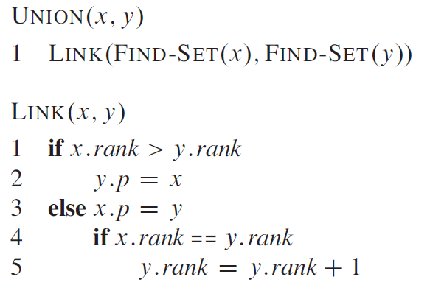
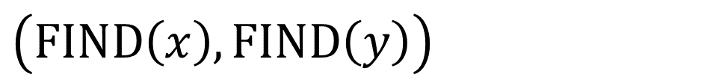
// one root points to the other
$$\left(\text{FIND}\left(x\right),\text{FIND}\left(y\right)\right)$$
// implements union by rank
// rank bounds tree depth
// connect shallower tree to deeper
// only equal ranks increases
union’s root rank

Slide 13
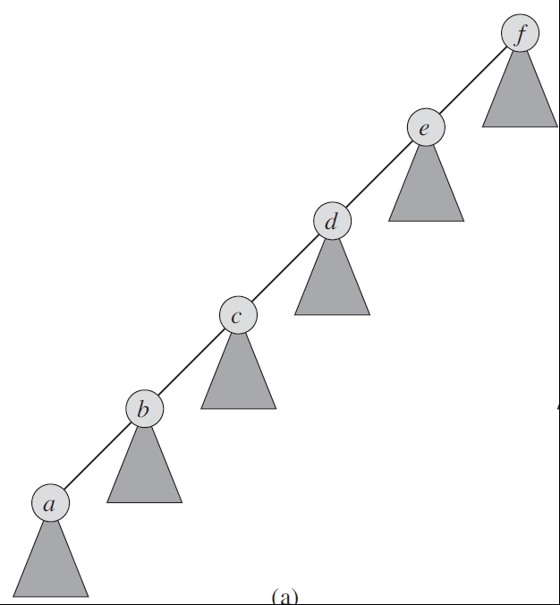
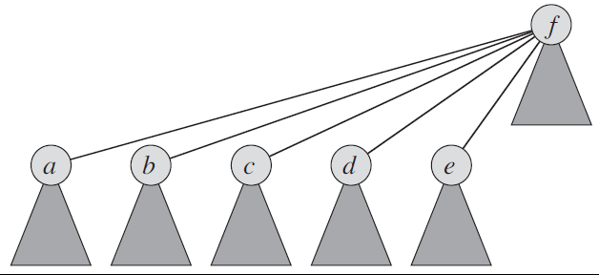
Path compression flattens tree

Slide 14
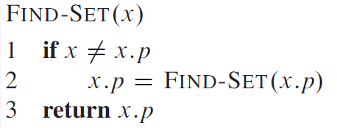
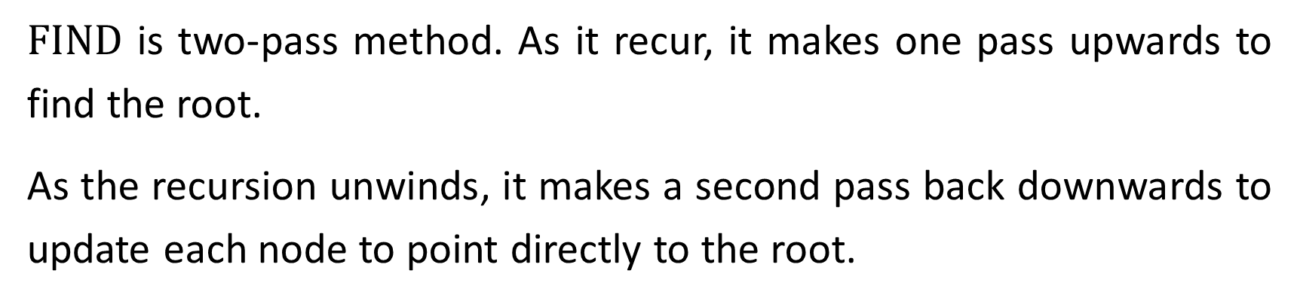


$$(x)$$
// simultaneous find and path compression
// check for root
$$\text{FIND}\left(x.p\right)$$
// recursive upward pass
// return the root which points to itself
$\text{FIND}$ is two-pass method. As it recur, it makes one pass upwards to find the root.
As the recursion unwinds, it makes a second pass back downwards to update each node to point directly to the root.

Slide 15
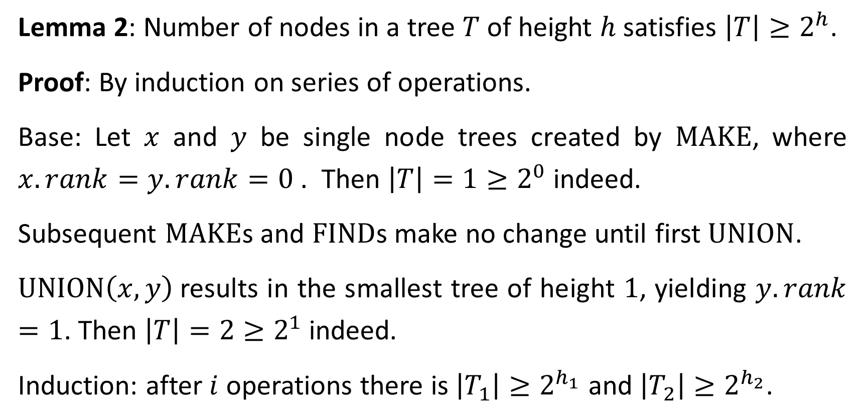
Lemma 2: Number of nodes in a tree $T$ of height $h$ satisfies $\left|T\right|≥2^{h}$.
Proof: By induction on series of operations.
Base: Let $x$ and $y$ be single node trees created by $\text{MAKE}$, where $x.rank=y.rank=0$ . Then $\left|T\right|=1≥2^{0}$ indeed.
Subsequent $\text{MAKE}$s and $\text{FIND}$s make no change until first $\text{UNION}$.
$\text{UNION}\left(x,y\right)$results in the smallest tree of height $1$, yielding $y.rank=1$. Then $\left|T\right|=2≥2^{1}$ indeed.
Induction: after $i$ operations there is $\left|T_{1}\right|≥2^{h_{1}}$ and $\left|T_{2}\right|≥2^{h_{2}}$.

Slide 16
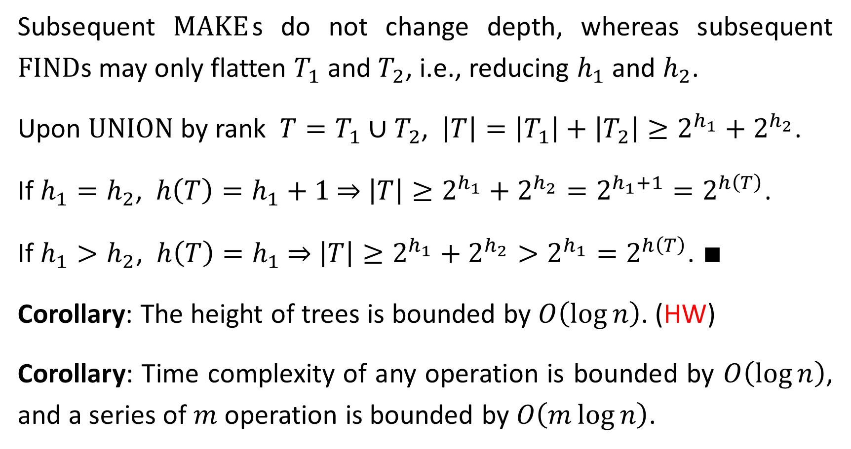
Subsequent $\text{MAKE}$s do not change depth, whereas subsequent $\text{FIND}$s may only flatten $T_{1}$ and $T_{2}$, i.e., reducing $h_{1}$ and $h_{2}$.
Upon $\text{UNION}$ by rank $T=T_{1}∪T_{2}$, $\left|T\right|=\left|T_{1}\right|+\left|T_{2}\right|≥2^{h_{1}}+2^{h_{2}}$.
If $h_{1}=h_{2}$, $h\left(T\right)=h_{1}+1$ ⇒ $\left|T\right|≥2^{h_{1}}+2^{h_{2}}=2^{h_{1}+1}=2^{h\left(T\right)}$.
If $h_{1}>h_{2}$, $h\left(T\right)=h_{1}$ ⇒ $\left|T\right|≥2^{h_{1}}+2^{h_{2}}>2^{h_{1}}=2^{h\left(T\right)}$. ∎
Corollary: The height of trees is bounded by $O\left(\log{n}\right)$. (HW)
Corollary: Time complexity of any operation is bounded by $O\left(\log{n}\right)$, and a series of $m$ operation is bounded by $O\left(m\log{n}\right)$.

Slide 17
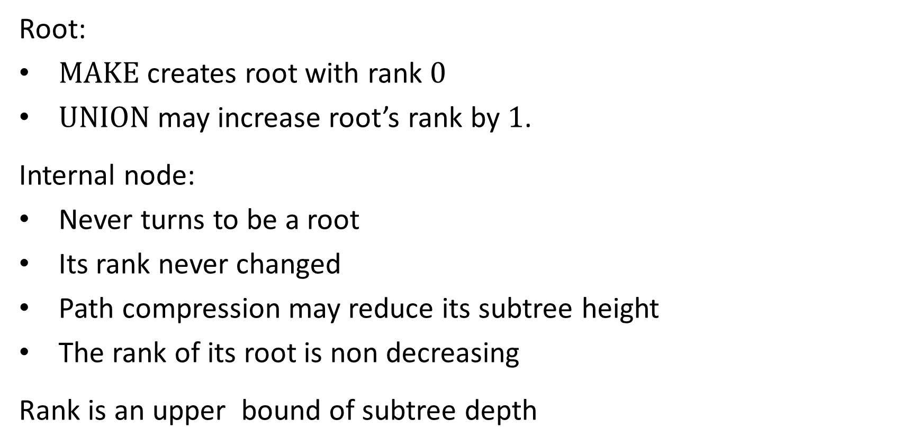
Analysis of Union by Rank and Path Compression
Root:
$\text{MAKE}$ creates root with rank $0$
$\text{UNION}$ may increase root’s rank by $1$.
Internal node:
Never turns to be a root
Its rank never changed
Path compression may reduce its subtree height
The rank of its root is non decreasing
Rank is an upper bound of subtree depth

Slide 18
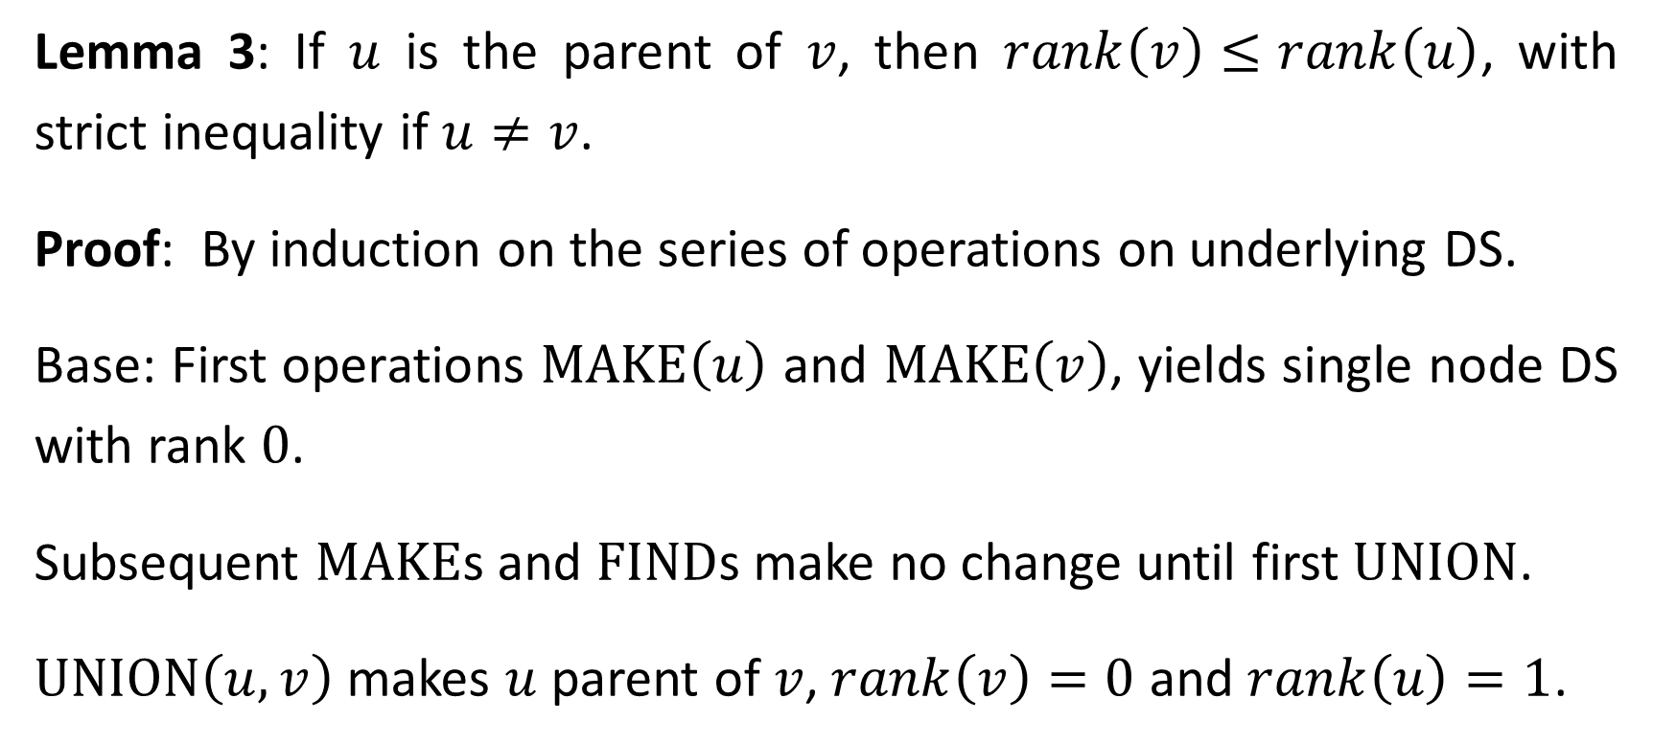
Lemma 3: If $u$ is the parent of $v$, then $rank\left(v\right)≤rank\left(u\right)$, with strict inequality if $u≠v$.
Proof: By induction on the series of operations on underlying DS.
Base: First operations $\text{MAKE}\left(u\right)$ and $\text{MAKE}\left(v\right)$, yields single node DS with rank $0$.
Subsequent $\text{MAKE}$s and $\text{FIND}$s make no change until first $\text{UNION}$.
$\text{UNION}\left(u,v\right)$ makes $u$ parent of $v$, $rank\left(v\right)=0$ and $rank\left(u\right)=1$.

Slide 19
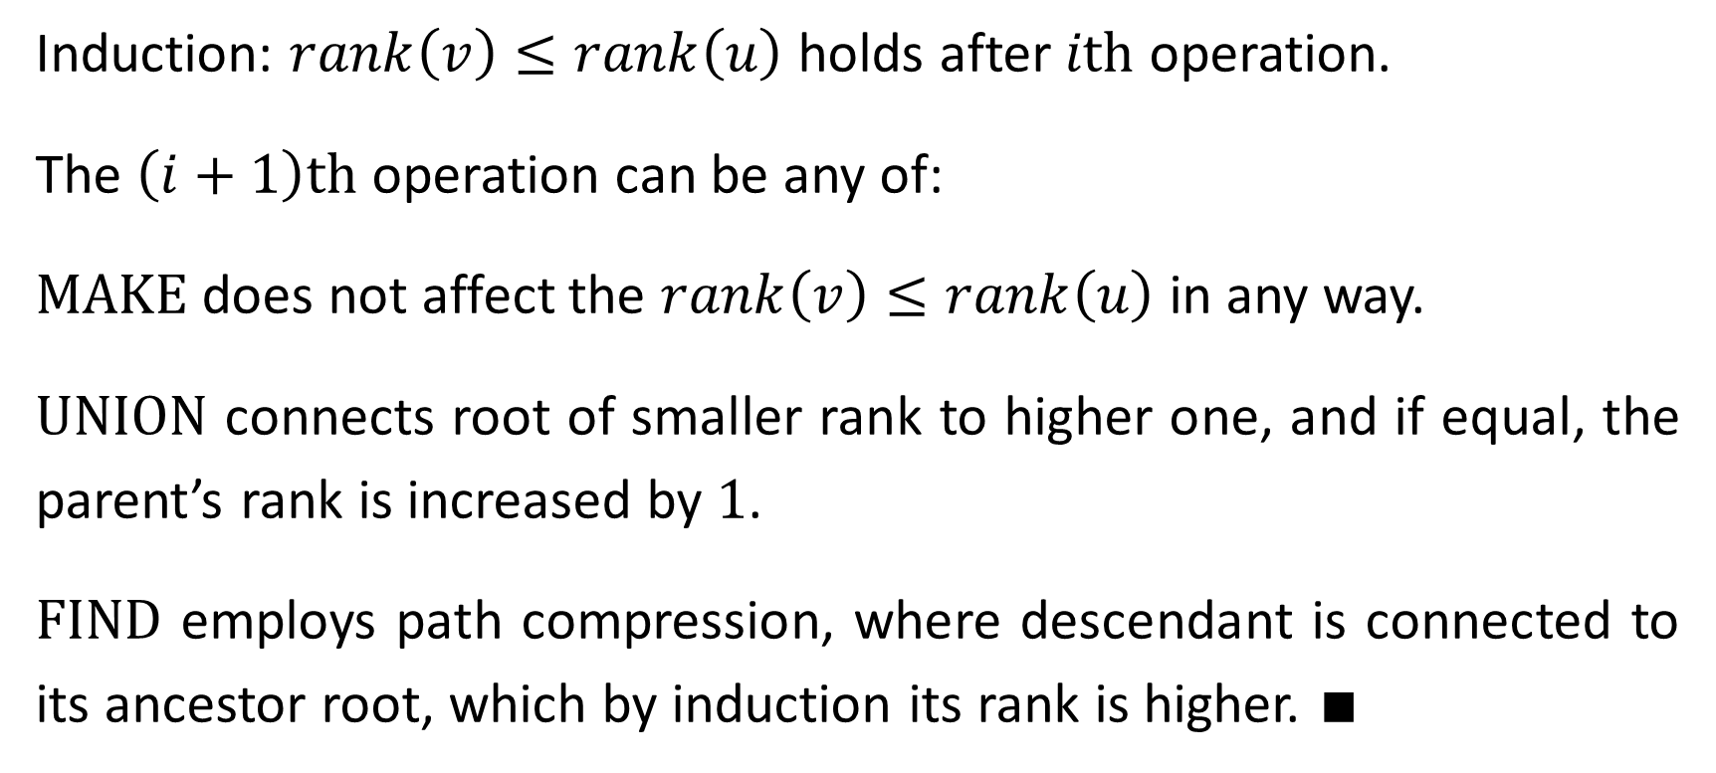
Induction: $rank\left(v\right)≤rank\left(u\right)$ holds after $i\text{th}$ operation.
The $\left(i+1\right)\text{th}$ operation can be any of:
$\text{MAKE}$does not affect the $rank\left(v\right)≤rank\left(u\right)$ in any way.
$\text{UNION}$ connects root of smaller rank to higher one, and if equal, the parent’s rank is increased by $1$.
$\text{FIND}$ employs path compression, where descendant is connected to its ancestor root, which by induction its rank is higher. ∎

Slide 20
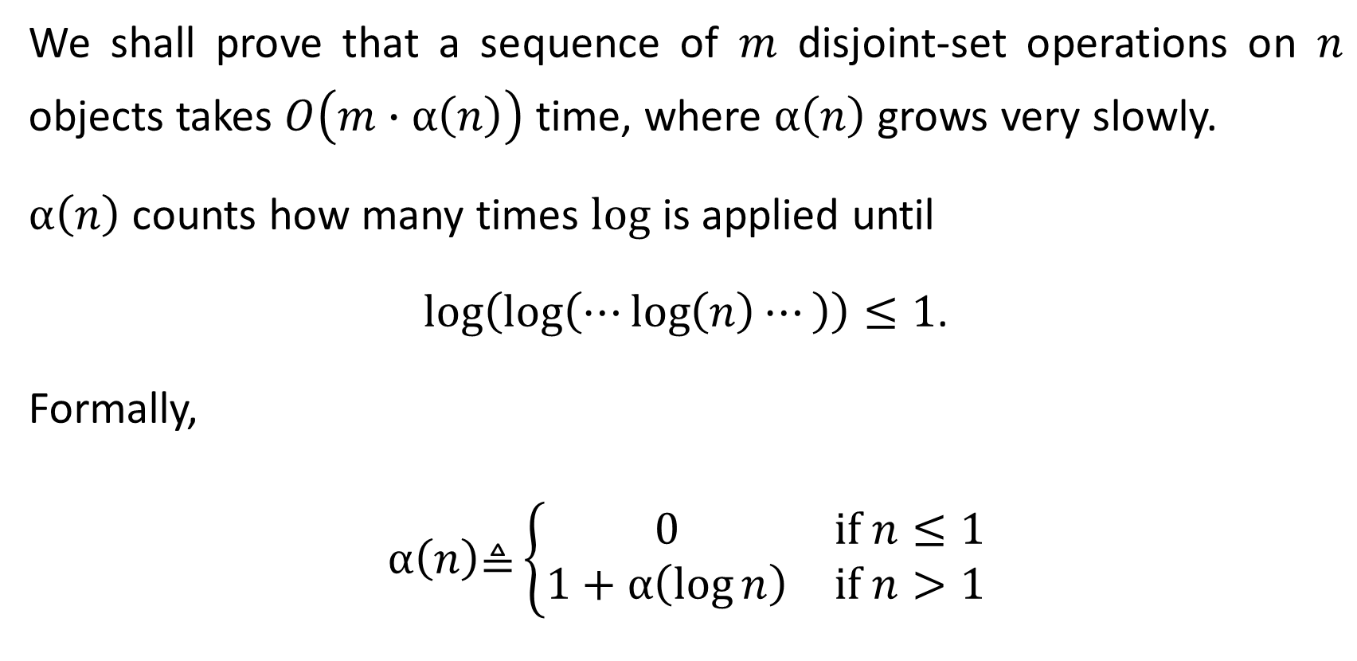
We shall prove that a sequence of $m$ disjoint-set operations on $n$ objects takes $O\left(m∙α\left(n\right)\right)$ time, where $α\left(n\right)$ grows very slowly.
$α\left(n\right)$ counts how many times $\text{log}$ is applied until
$\log\left(\log\left(⋯\log\left(n\right)⋯\right)\right)≤1$.
Formally,
$$α\left(n\right)\text{≜}\left\{\begin{matrix}0 & \text{if} n≤1 \\ 1+α\left(\log{n}\right) & \text{if} n>1\end{matrix}\right.$$

Slide 21
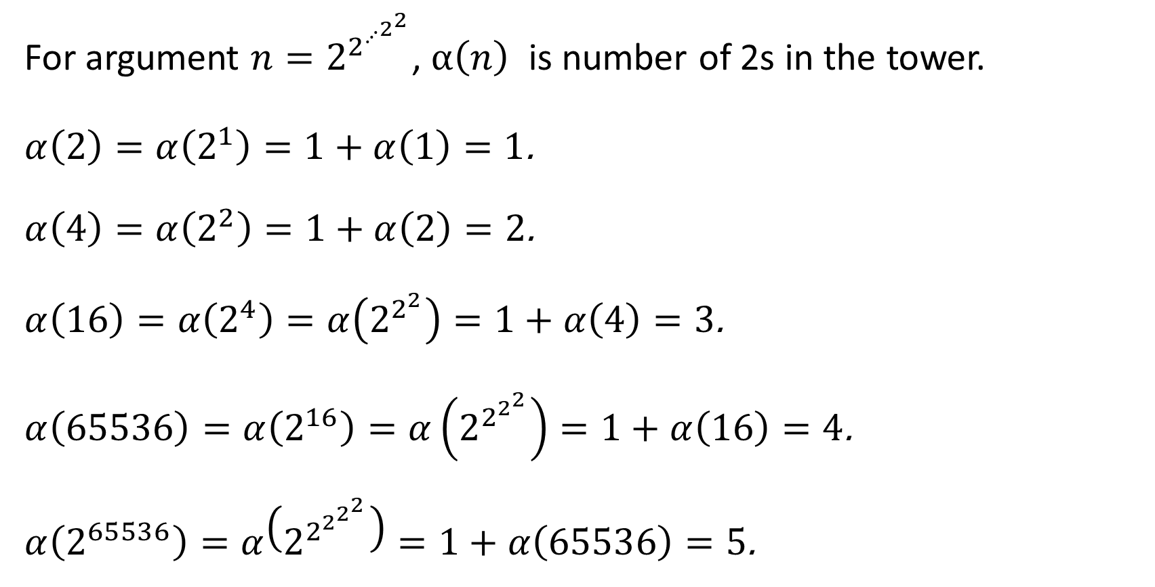
For argument $n=2^{2^{⋰^{2^{2}}}}$, $α\left(n\right)$ is number of 2s in the tower.
$α\left(2\right)=α\left(2^{1}\right)=1+α\left(1\right)=1$.
$α\left(4\right)=α\left(2^{2}\right)=1+α\left(2\right)=2$.
$α\left(16\right)=α\left(2^{4}\right)=α\left(2^{2^{2}}\right)=1+α\left(4\right)=3$.
$α\left(65536\right)=α\left(2^{16}\right)=α\left(2^{2^{2^{2}}}\right)=1+α\left(16\right)=4$.
$α\left(2^{65536}\right)=α\left(2^{2^{2^{2^{2}}}}\right)=1+α\left(65536\right)=5$.

Slide 22
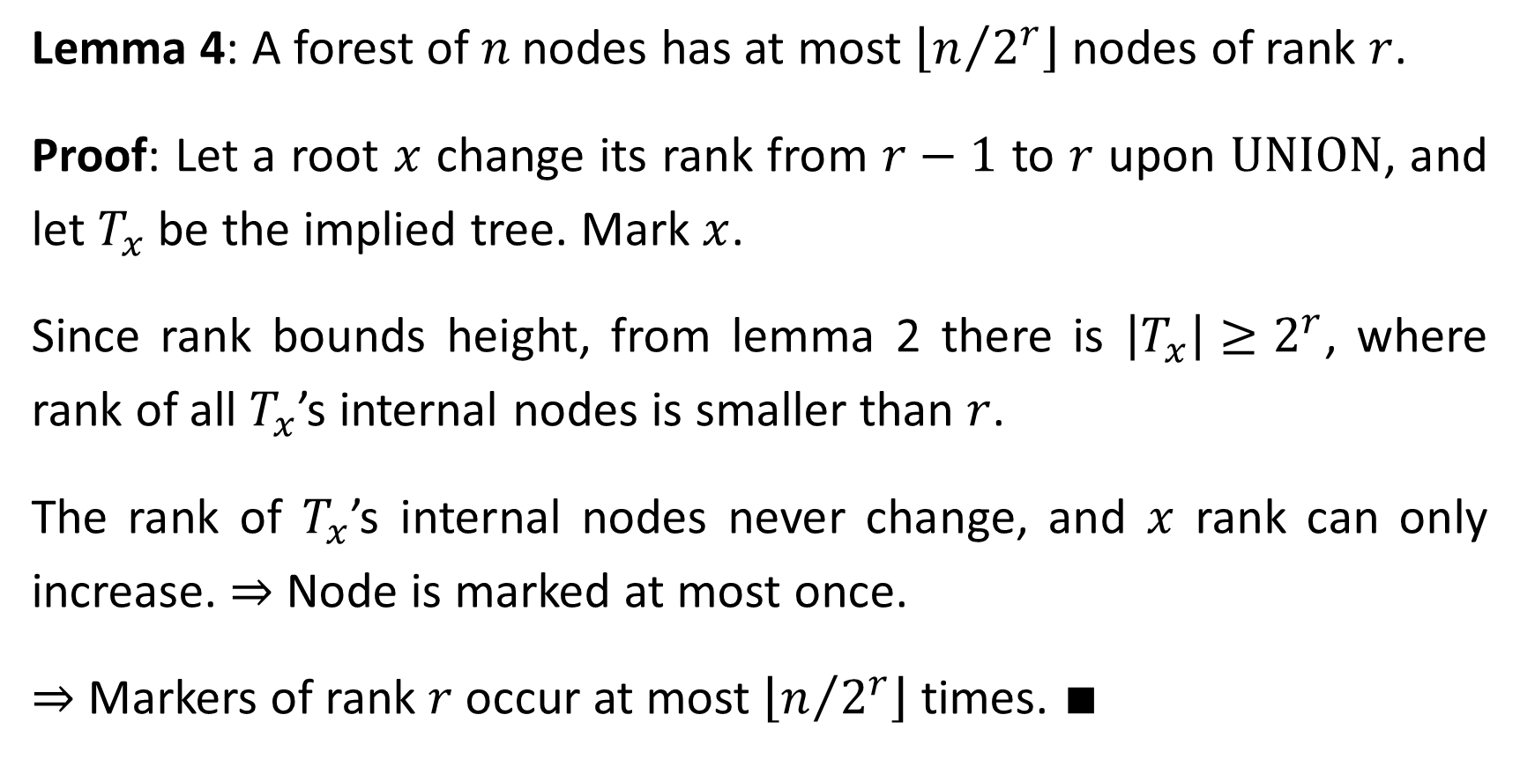
Lemma 4: A forest of$n$ nodes has at most $\left\lfloor n/{2^{r}}\right\rfloor$ nodes of rank $r$.
Proof: Let a root $x$ change its rank from $r−1$ to $r$ upon $\text{UNION}$, and let $T_{x}$ be the implied tree. Mark $x$.
Since rank bounds height, from lemma 2 there is $\left|T_{x}\right|≥2^{r}$, where rank of all $T_{x}$’s internal nodes is smaller than $r$.
The rank of $T_{x}$’s internal nodes never change, and $x$ rank can only increase. ⇒ Node is marked at most once.
⇒ Markers of rank $r$occur at most $\left\lfloor n/{2^{r}}\right\rfloor$ times. ∎

Slide 23
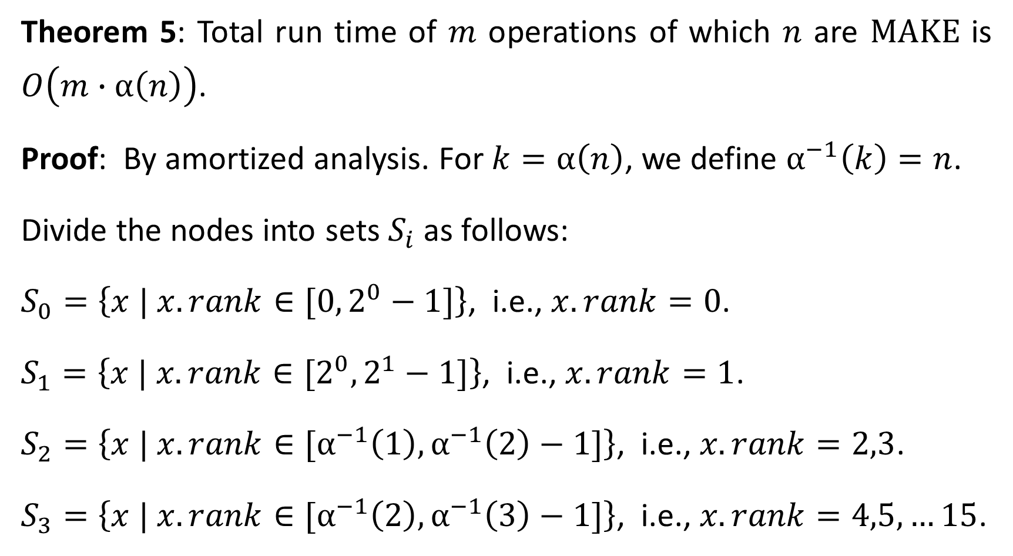
Theorem 5: Total run time of $m$ operations of which $n$ are $\text{MAKE}$ is $O\left(m∙α\left(n\right)\right)$.
Proof: By amortized analysis. For $k=α\left(n\right)$, we define $α^{−1}\left(k\right)=n$.
Divide the nodes into sets $S_{i}$ as follows:
$S_{0}=\left\{x | x.rank∈[0, 2^{0}−1]\right\}$, i.e., $x.rank=0$.
$S_{1}=\left\{x | x.rank∈[2^{0},2^{1}−1]\right\}$, i.e., $x.rank=1$.
$S_{2}=\left\{x | x.rank∈[α^{−1}\left(1\right),α^{−1}\left(2\right)−1]\right\}$, i.e., $x.rank=2,3$.
$S_{3}=\left\{x | x.rank∈[α^{−1}\left(2\right),α^{−1}\left(3\right)−1]\right\}$, i.e., $x.rank=4,5,…15$.

Slide 24
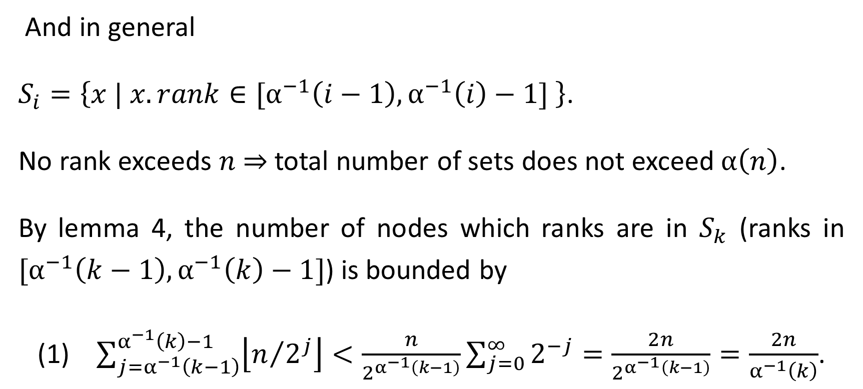
And in general
$S_{i}=\left\{x | x.rank∈[α^{−1}\left(i−1\right),α^{−1}\left(i\right)−1] \right\}$.
No rank exceeds $n$ ⇒ total number of sets does not exceed $α\left(n\right)$.
By lemma 4, the number of nodes which ranks are in $S_{k}$ (ranks in $[α^{−1}\left(k−1\right),α^{−1}\left(k\right)−1]$) is bounded by
(1) $\sum_{j=α^{−1}\left(k−1\right)}^{α^{−1}\left(k\right)−1}{\left\lfloor n/{2^{j}}\right\rfloor }<\frac{n}{2^{α^{−1}\left(k−1\right)}}\sum_{j=0}^{∞}{2^{−j}}=\frac{2n}{2^{α^{−1}\left(k−1\right)}}=\frac{2n}{α^{−1}\left(k\right)}$.

Slide 25
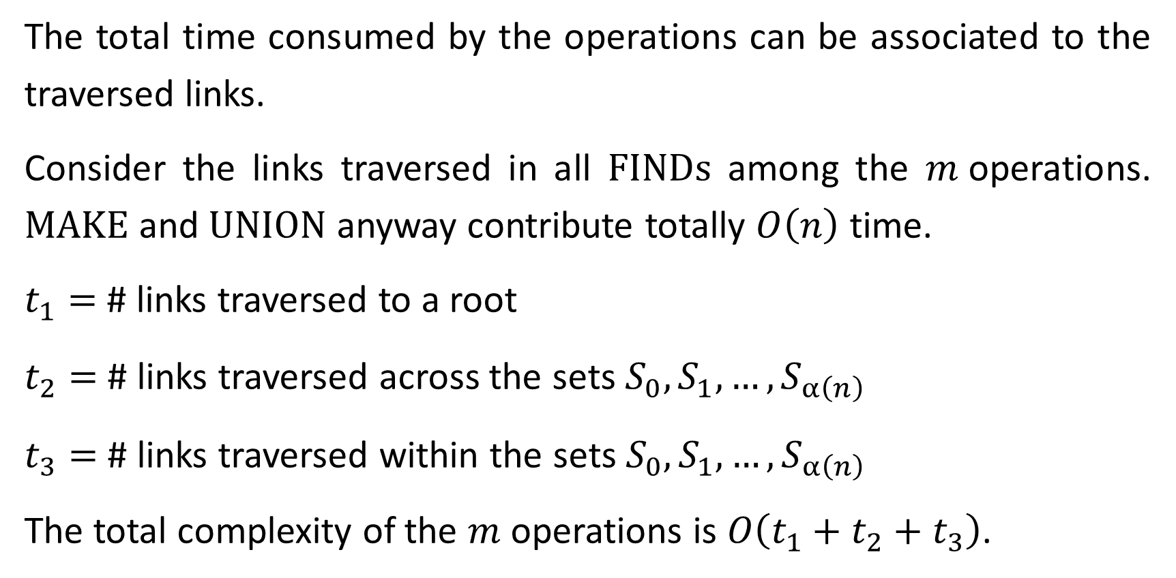
The total time consumed by the operations can be associated to the traversed links.
Consider the links traversed in all $\text{FINDs}$ among the $m$operations. MAKE and UNION anyway contribute totally $O\left(n\right)$ time.
$t_{1}=$ # links traversed to a root
$t_{2}=$ # links traversed across the sets $S_{0},S_{1},…,S_{α\left(n\right)}$
$t_{3}=$ # links traversed within the sets $S_{0},S_{1},…,S_{α\left(n\right)}$
The total complexity of the $m$ operations is $O\left(t_{1}+t_{2}+t_{3}\right)$.

Slide 26


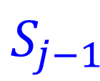





$$t_{1}$$
$$t_{3}$$
$$t_{2}$$
$$S_{j−1}$$
Path compression flattens tree
$$t_{1}$$
$$t_{3}$$
$$t_{3}$$
$$S_{j}$$

Slide 27
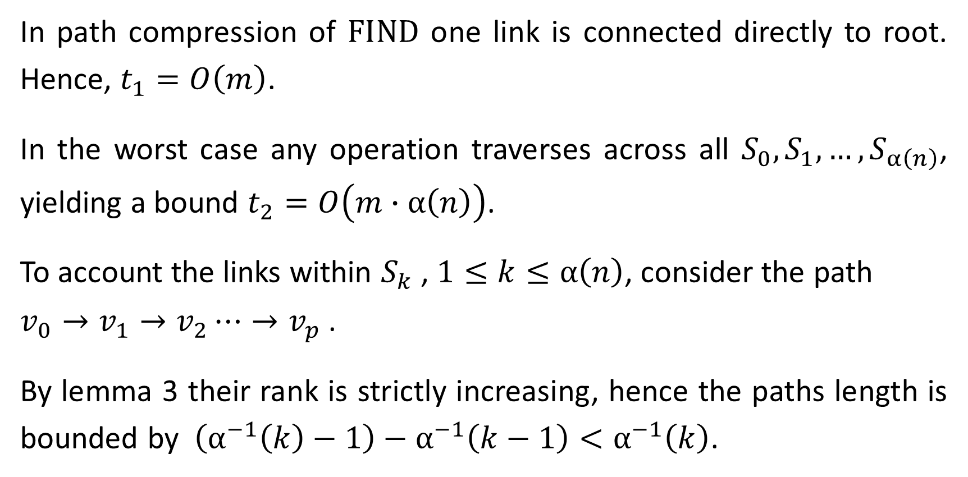
In path compression of FIND one link is connected directly to root. Hence, $t_{1}=O\left(m\right)$.
In the worst case any operation traverses across all $S_{0},S_{1},…,S_{α\left(n\right)}$, yielding a bound $t_{2}=O\left(m∙α\left(n\right)\right)$.
To account the links within $S_{k}$ , $1≤k≤α\left(n\right)$, consider the path
$v_{0}→v_{1}→v_{2}⋯→v_{p}$ .
By lemma 3 their rank is strictly increasing, hence the paths length is bounded by $\left(α^{−1}\left(k\right)−1\right)−α^{−1}\left(k−1\right)<α^{−1}\left(k\right)$.

Slide 28
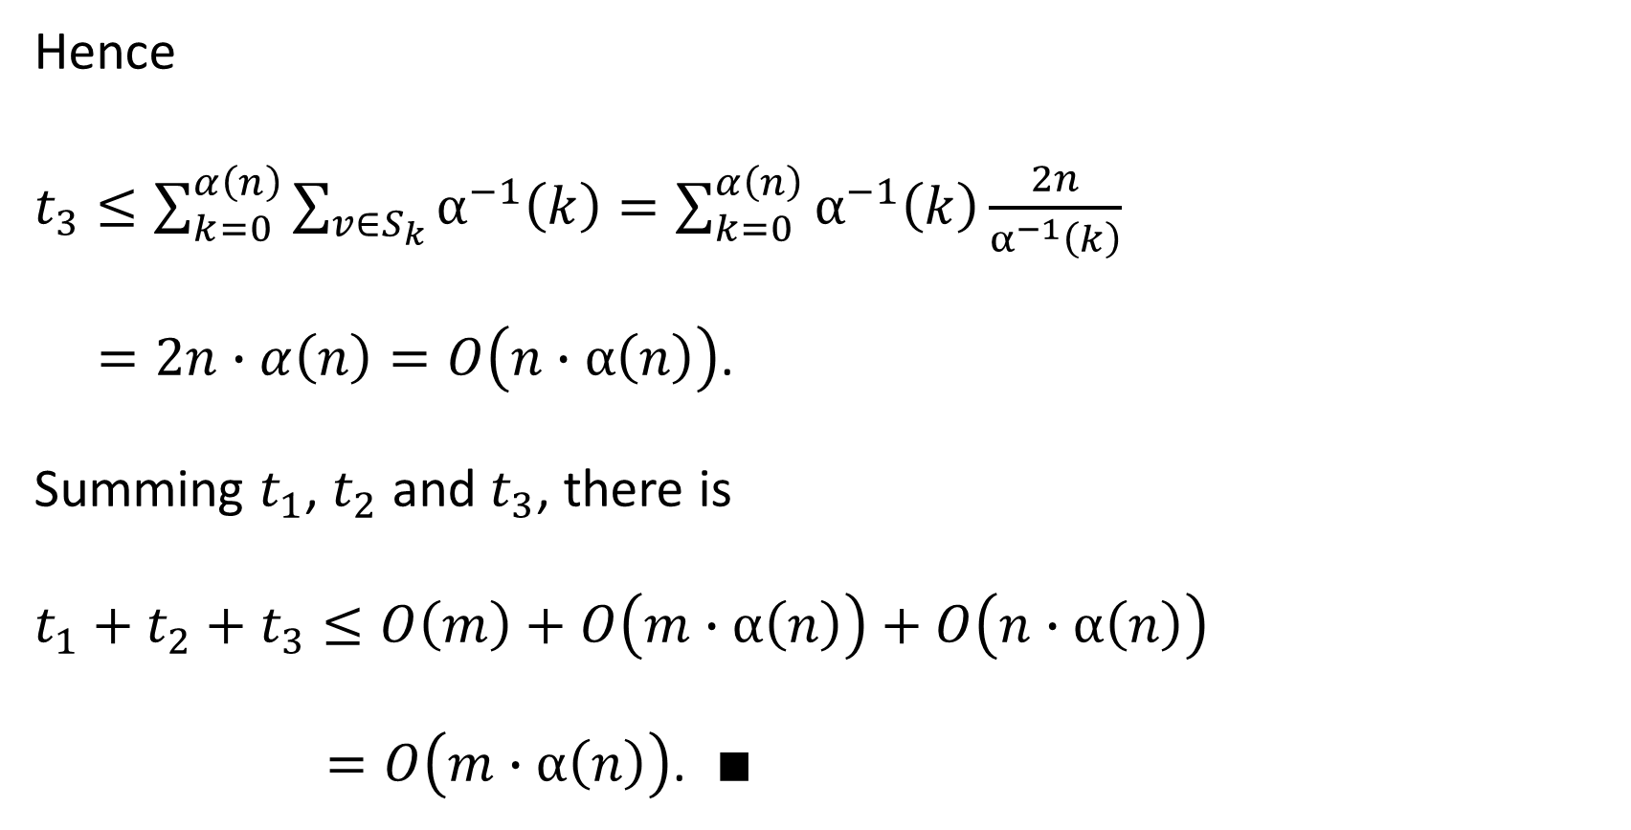
Hence
$t_{3}≤\sum_{k=0}^{α\left(n\right)}{\sum_{v∈S_{k}}{α^{−1}\left(k\right)}}=\sum_{k=0}^{α\left(n\right)}{α^{−1}\left(k\right)\frac{2n}{α^{−1}\left(k\right)}}$
$=2n∙α\left(n\right)=O\left(n∙α\left(n\right)\right)$.
Summing $t_{1}$, $t_{2}$ and $t_{3}$, there is
$t_{1}+t_{2}+t_{3}≤O\left(m\right)+O\left(m∙α\left(n\right)\right)+O\left(n∙α\left(n\right)\right)$
$=O\left(m∙α\left(n\right)\right)$. ∎
(1)

